Slide 1


AI-Powered Security for Cloud Containers
This presentation outlines an AI-powered security solution. It addresses the risks of running applications in Docker containers. The system detects security flaws automatically by scanning continuously and feeding the log data and the system resources to the ML model. It alerts users about potential threats, reducing risks for DevOps teams.

Slide 2
Problem: Container Security Risks
Software Code
Dependencies
Resource Analysis
Security flaws in containerized applications can lead to breaches.
Vulnerabilities in libraries and dependencies are a common attack vector.
Unusual CPU, memory, or log activity indicates compromise.

Slide 3




Monitoring Workflow
Add Container
Enter the container's API key to begin monitoring.
Real-Time Monitoring
Continuously check logs, CPU, memory, and software vulnerabilities.
AI Anomaly Detection
Use LSTM and BERT to identify real attacks, minimizing false positives.

Slide 4



Security Scanning with Anchore
Vulnerability Scan
Critical Issue Alert
Anchore scans containers for known CVE vulnerabilities.
Generate alerts upon detecting critical vulnerabilities.

Slide 5
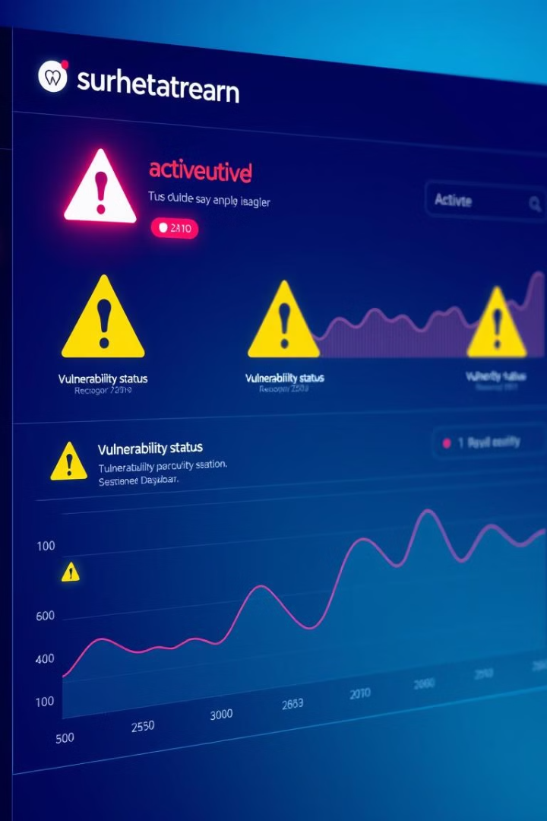


Alerts and Prevention
Alert
The system sends an alert to the user's dashboard.
Prevention
Suggests actions like updating OpenSSL.

Slide 6

Key Technologies Used
FastAPI
MongoDB (Atlas)
Handles backend API requests efficiently.
Stores user data and security alerts securely.
React
Displays real-time security alerts on the frontend.

Slide 7
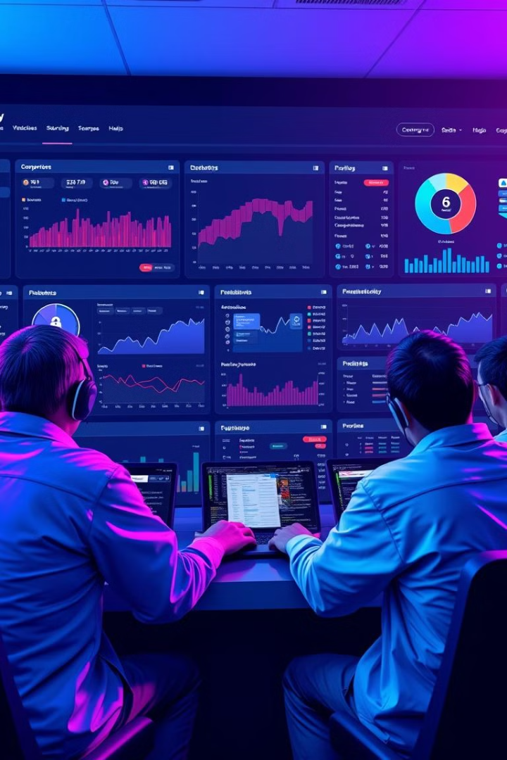



Final Outcome: Secure Dashboard
Add Containers
Real-time Alerts
Users can easily add containers for monitoring.
Immediate notifications for vulnerabilities and attacks.
AI Detection
AI-based anomaly detection prevents hacking attempts.

Slide 8



Why This Matters
Application Security
1
Prevents cyberattacks on cloud applications.
Risk Reduction
2
Reduces security risks for DevOps teams.
Secure Deployments
3
Helps businesses secure software deployments.

